Slide 1


Brokering Techniques for Managing Three-Tier Applications in Distributed Cloud Computing Environments
Nikolay Grozev
Supervisor: Prof. Rajkumar Buyya
7th October 2015
PhD Completion Seminar

Slide 3
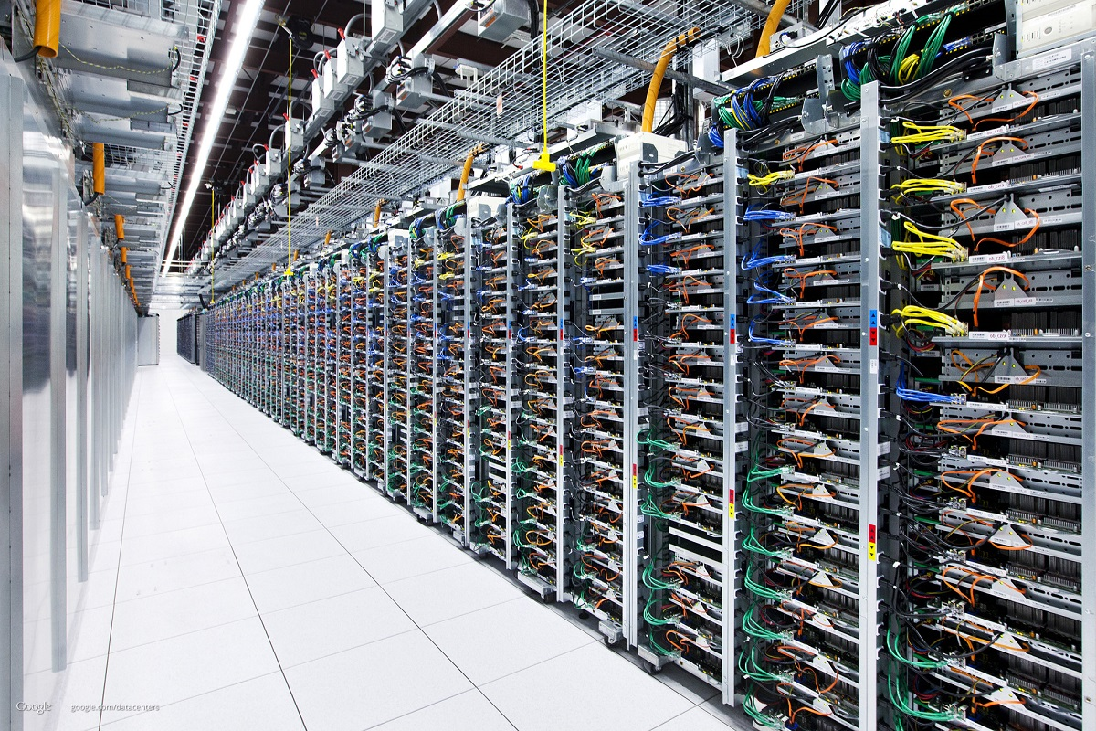
Cloud Computing
Cloud computing ...
is a model for delivering virtualized computing resources over the Internet;
is supported by large scale data centres aggregating commodity hardware;
is subscription based (pay-as-you-go);
Challenges - outages, security, etc.
www.google.com/datacenters/

Slide 4
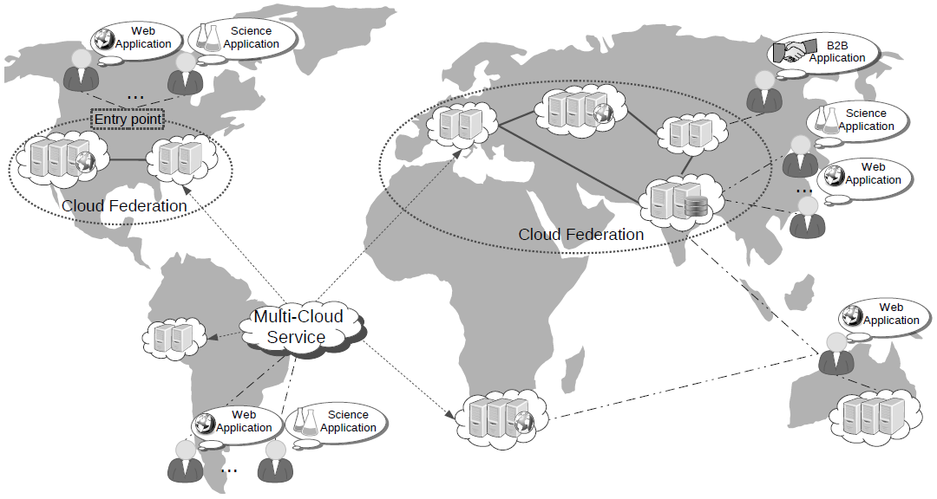
Inter-Cloud Computing
Motivation:
Mitigate effects of cloud outage;
Diversify geographical locations;
Avoid vendor lock-in;
Latency.
Solution - use multiple clouds

Slide 5
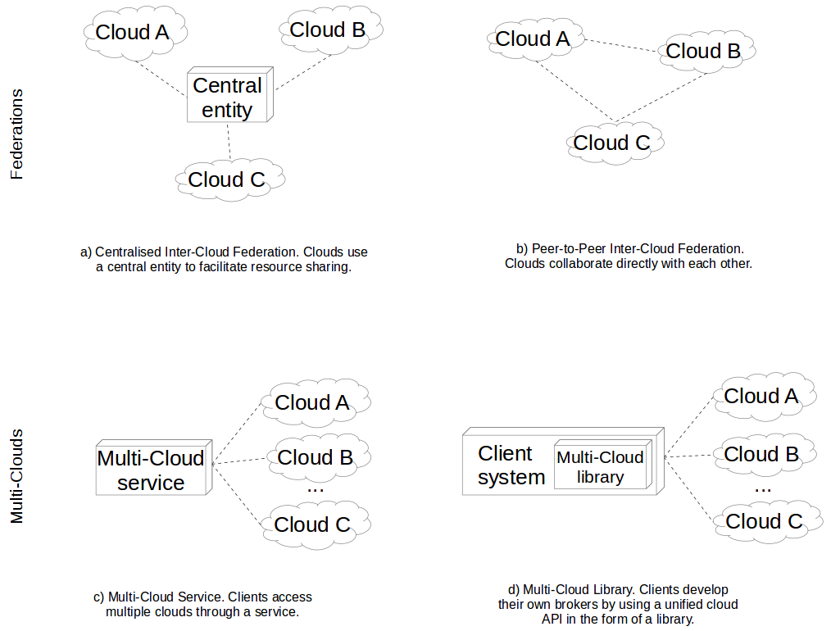
Inter-Cloud Computing: Architectures

Slide 6
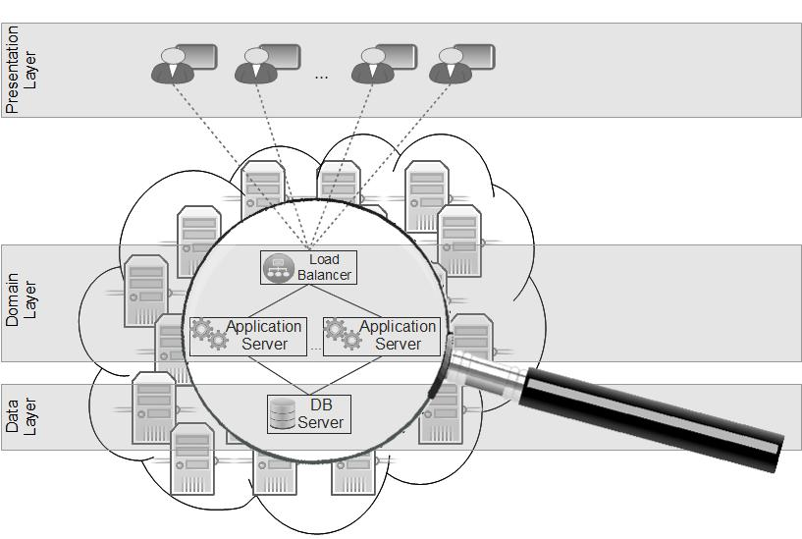
3-Tier applications in cloud

Slide 7
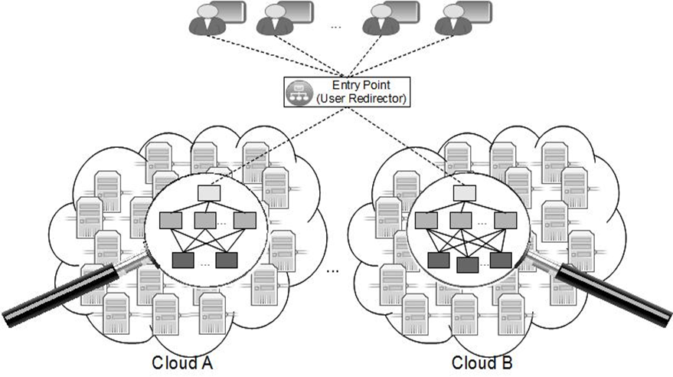
3-Tier applications in a Multi-Cloud

Slide 8
Research Question
?
How to broker 3-Tier applications in a Multi-Cloud environment, considering Quality of Service (QoS) requirements in terms of:
Network Latency Awareness — end users should be served near their geographical location to experience better responsiveness;
Pricing Awareness— the overall costs for hosting should be minimized;
Legislation/Policy Awareness — legal and political considerations about where individual users are served should be honoured;
Code Re-usability — few changes to existing 3-Tier applications should be made. The technical overhead of moving an existing 3-Tier system to a Multi-Cloud should be minimal.

Slide 10
Background and Objectives
Distributed systems simulation has already fostered the research efforts;
Existing simulators can be used to simulate batch processing and infrastructure utilisation workloads only;
Previous works on multi-tier application modelling have series of shortcomings;
Goal – define a flexible and coarse grained model and simulator for 3-Tier applications in one and multiple clouds.

Slide 11
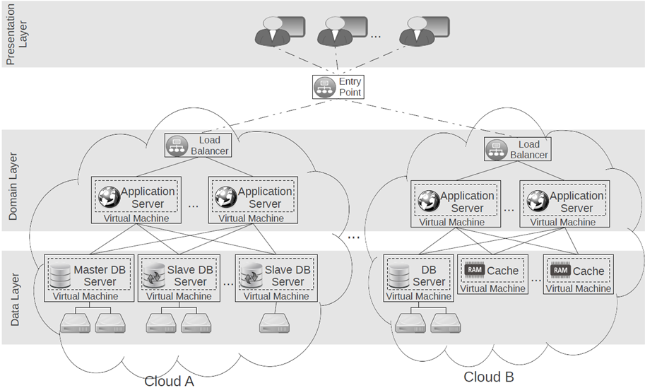
Target Scenario

Slide 12
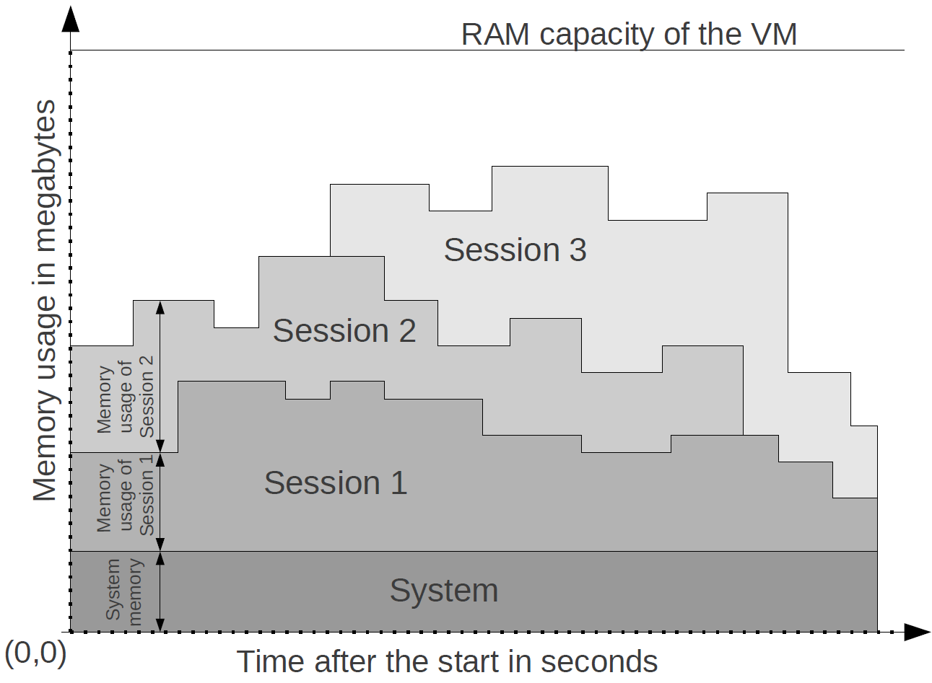
Session Performance Model
AS Memory Load -
AS CPU Load -
DB Memory Load -
DB CPU Load -
DB Disk I/O Load -
Step Size –
Session arrival model:
Model each session type separately
Poison distribution of a frequency function -

Slide 13
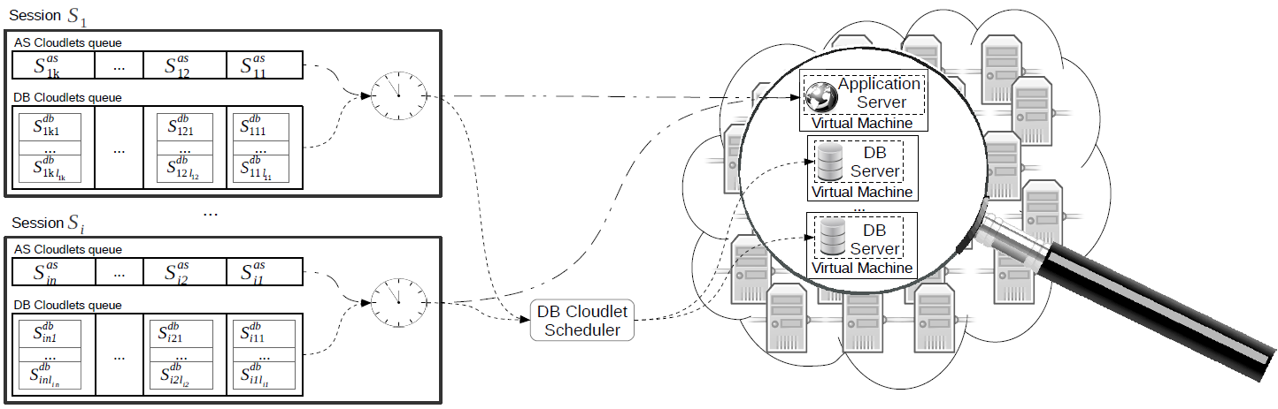
Simulator Implementation

Slide 14
Validation Environment
3-Tier app. designed after ebay;
Client application, generating requests;
Transition table;
"Think times“;
Experiments;
Benchmarking;
Experiment 1 - static workload on local infrastructure;
Experiment 2 - dynamic workload on local infrastructure (DC1) and EC2(DC2);

Slide 15
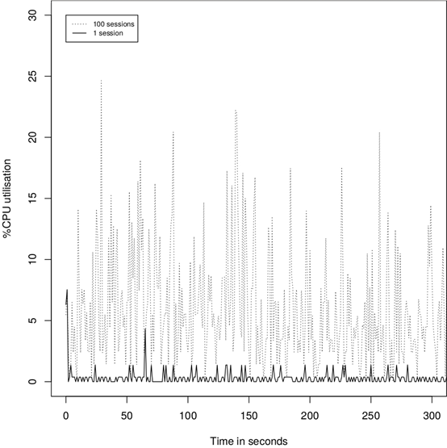
Model Extraction - Example
Execute 2 Experiments:
With 1 user;
With 100 users;
Compute the “average” session behavior;
Standard Linux utilisation measurement tools.
CPU utilisation of the DB server with 1 and 100 simultaneous sessions for the initial 5 minutes.

Slide 16
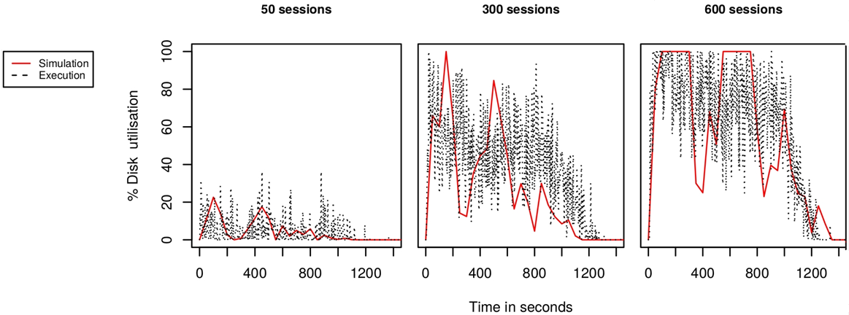
Experiment 1: Static Workload in 1 cloud
Predicted and actual disk I/O utilisation of the DB server with 50, 300, and 600 simultaneous sessions in Experiment 1.

Slide 18
Background and Objectives
Current Multi-Cloud 3-Tier have limitations manage resources and workload suboptimally;
They do not consider essential regulatory requirements;
Goal: propose a general and flexible architecture that honours key non-functional requirements and optimises cost and latency.

Slide 19
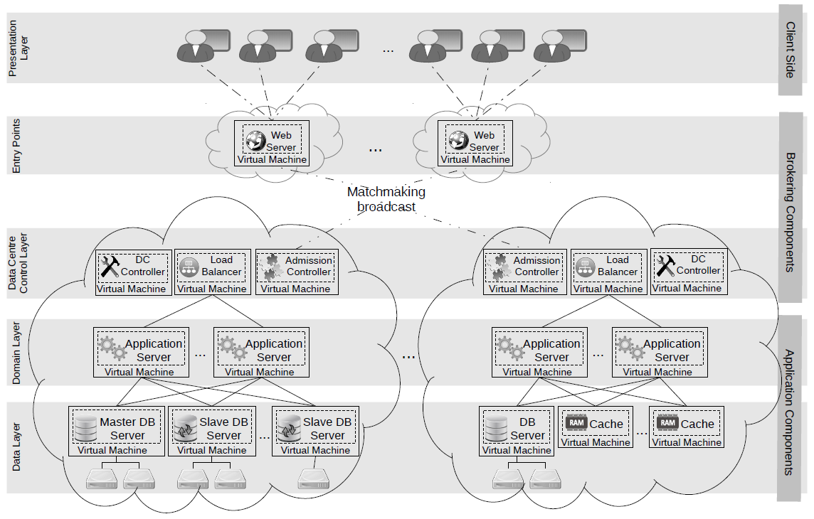
Overall Architecture

Slide 20
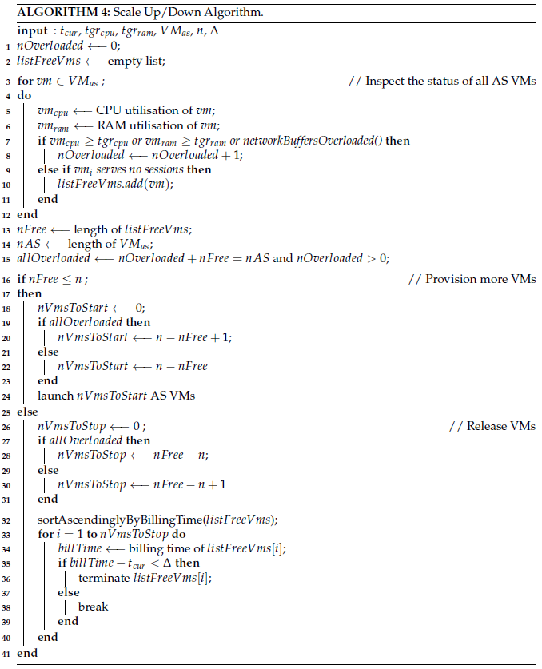
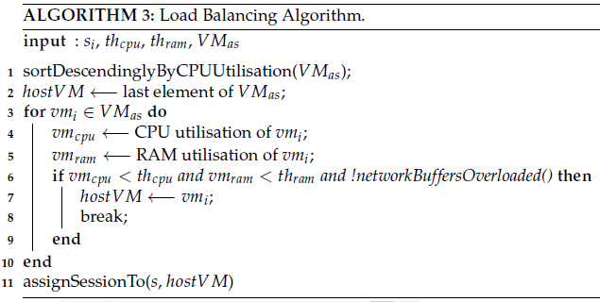
Load Balancing and Autoscaling
Load balancing algorithm – sticky or not?
Monitor VM utilization;
Free underutilized VMs.
Autoscaling algorithm:
Repeated periodically;
Number of pre-provisioned instances;
Do not terminate before billing time is over;

Slide 21
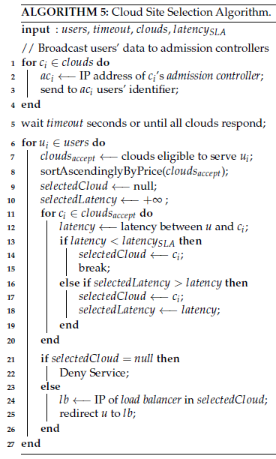
Cloud Selection Algorithm
Ensure users are served in eligible clouds;
Timeout;
Estimate network latency;
Estimate potential cost;
Overloaded infrastructure;
Optimise latency and cost.

Slide 22
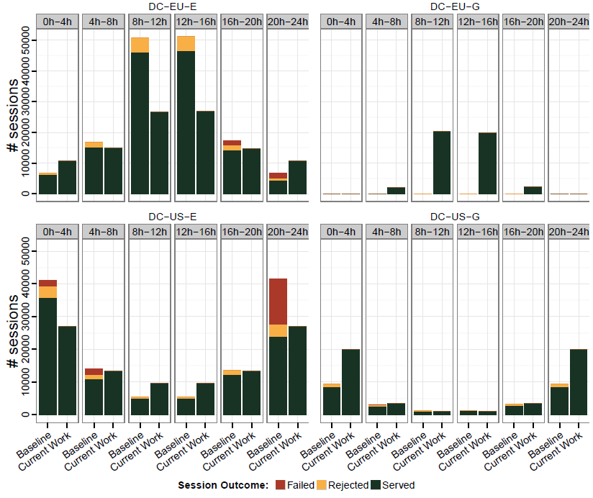
Performance Evaluation
Previous simulation env.;
Clouds of AWS and Google in the US and Europe;
Baseline:
AWS Route 53;
AWS Elastic LB;
AWS Autoscaling;

Slide 24
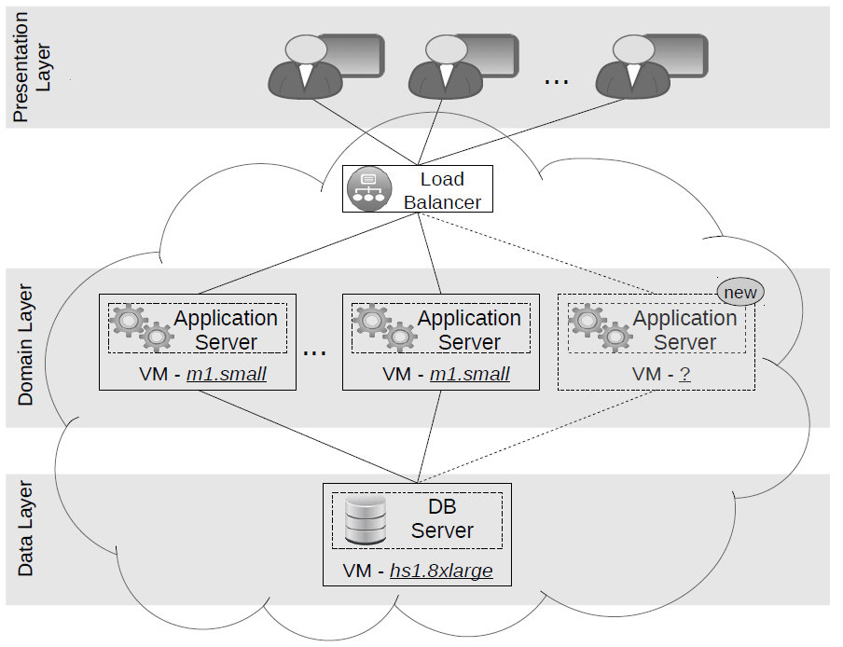
Background and Objectives
Current autoscaling approaches select VMs statically:
Applications change over time;
Workload changes over time;
Infrastructure capacity changes over time.
Goal: propose a flexible approach to VM selection that adapts to such changes.

Slide 25
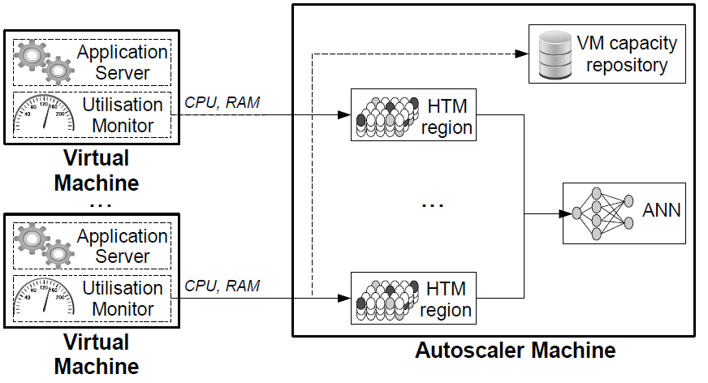
Approach Overview

Slide 26
Capacity Estimation and Normalisation
Linux kernel file: /proc/cpuinfo;
Mpstat: %steal, %idle, active_memory;
Frequencies: fr₁, ... fr_{n};
n_{max_cores}, f_{rmax}, RAM_{max};
.
.
.
.

Slide 27
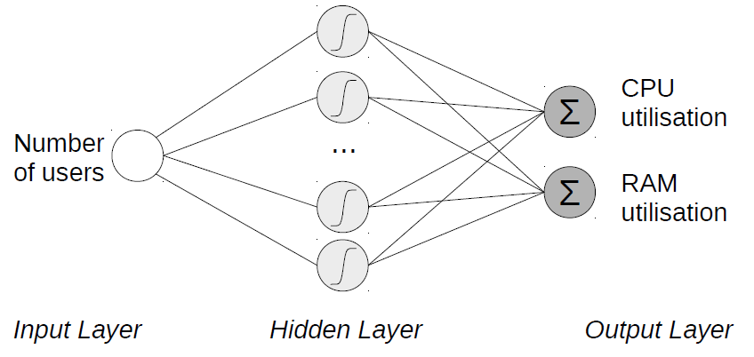
ANN based online regression
Learning rate and Momentum;
Increase learning rate in the beginning and when anomaly is detected;
Increase momentum at later stages and when no anomaly is detected;
Online training and filtering;

Slide 28
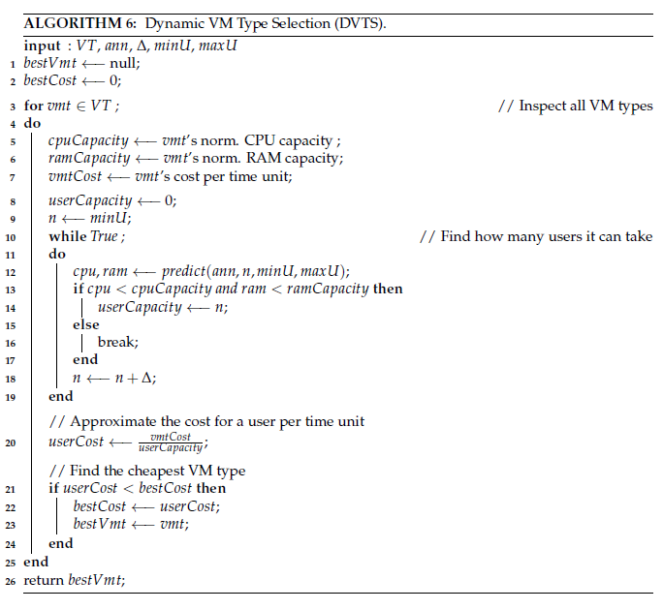
VM type selection algorithm
For each VM type:
Estimate its capacity;
Estimate how many users it can serve;
Choose best VM type in terms of cost per user;

Slide 29
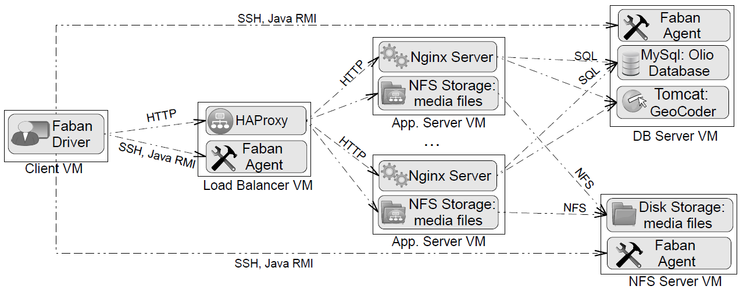
Experimental setup and workload
CloudStone in AWS EC2;
Choose best VM type in terms of cost per user;
Increasing workload for 5 hours;
Workload change after 3.5 hours;
Baseline – AWS-like autoscaling;

Slide 30
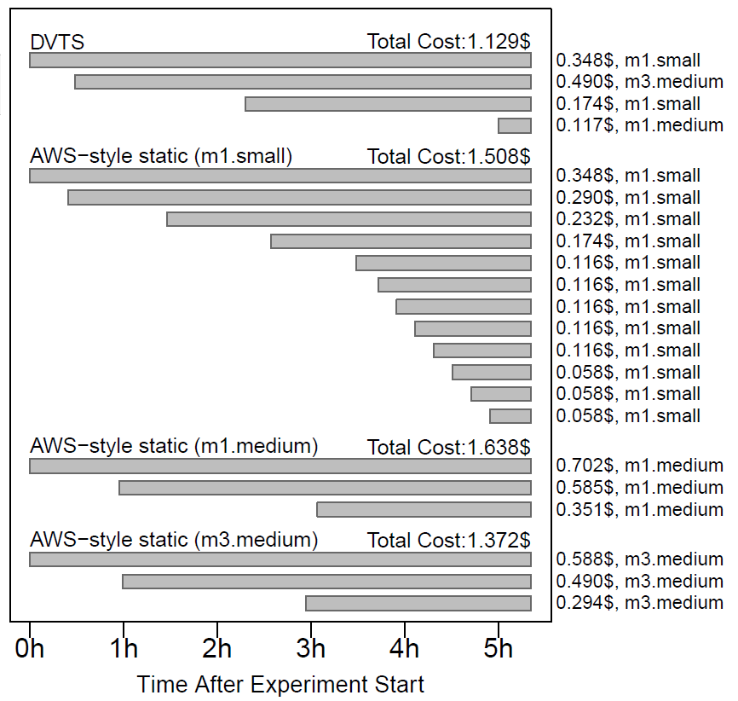
Experimental Results

Slide 32
Background and Objectives
How to implement the system from Chapter 4 with modern software technologies;
How to easily model user redirection requirements;

Slide 33
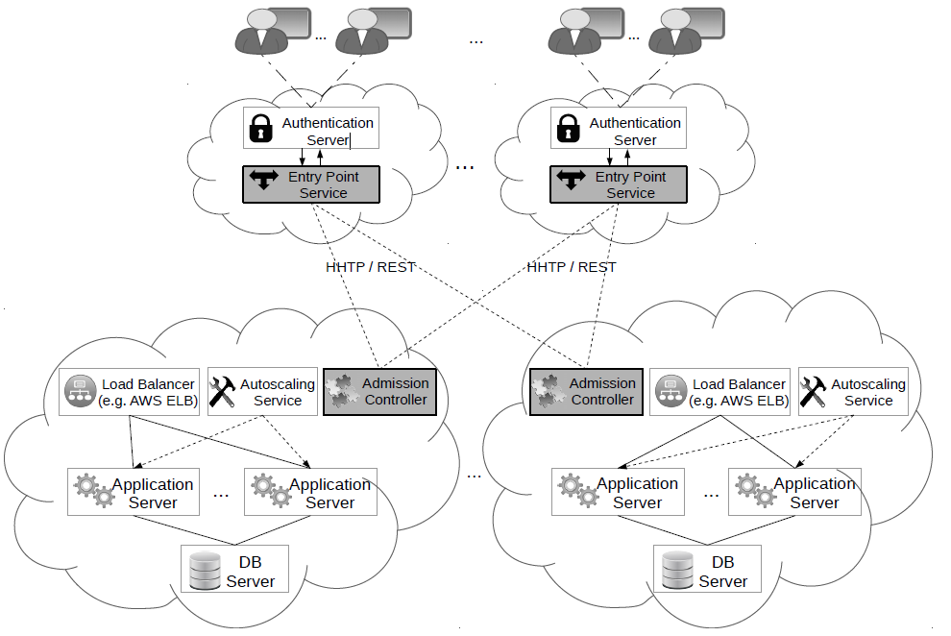
Scope

Slide 34
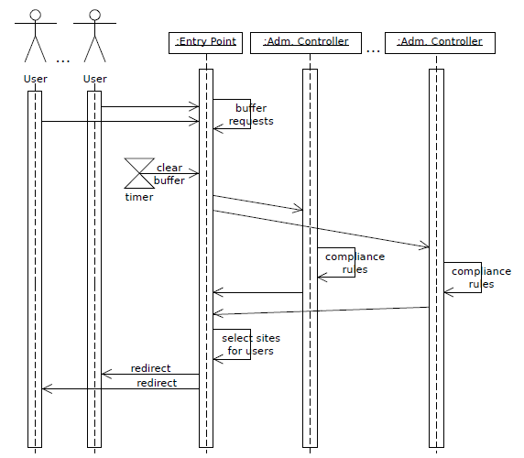
Entry Point – Admission Controller interaction
Restful web servers;
Entry Point buffers and sends requests in batch;
Admission Controller uses a rule inference engine;
Entry Point choses optimal cloud site.

Slide 35
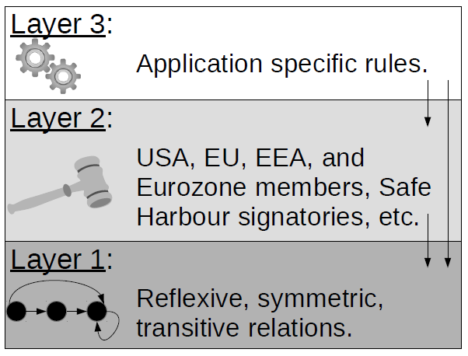
Admission rules
Drools rule inference engine;
3 layers of rules;
Polymorphism and rules;
Admission through contradiction.

Slide 36
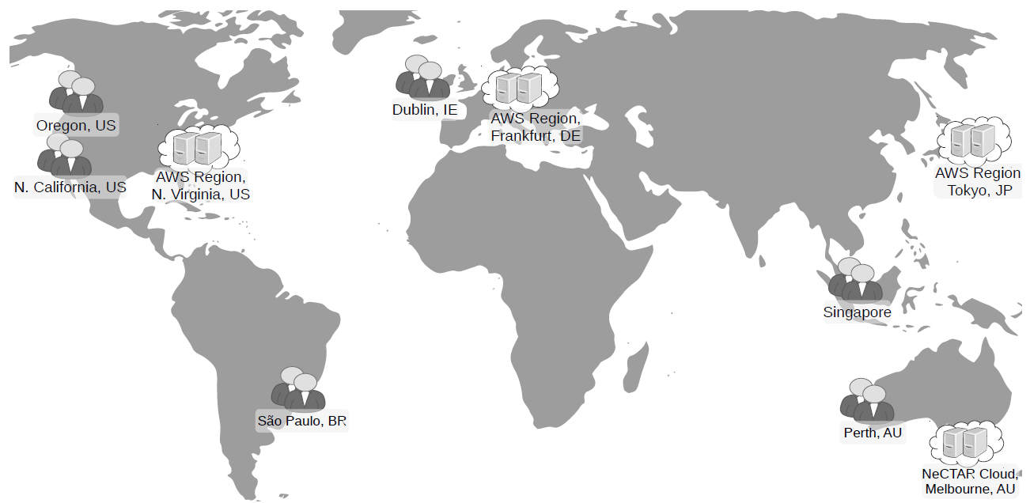
Experimental setup and workload
24 hours, 2 users per second;
50% of users require PCI-DSS compliant clouds;
Random citizenship: Germany, USA, Australia, or Canada;
50% of US citizens are government officials.

Slide 37
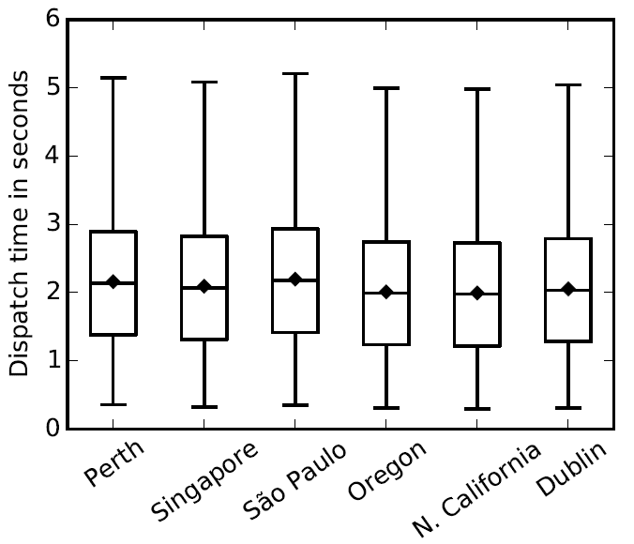
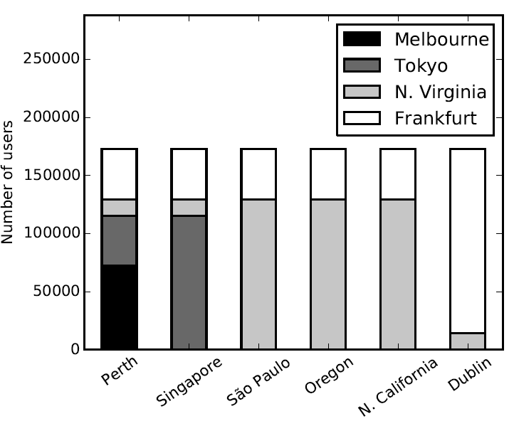
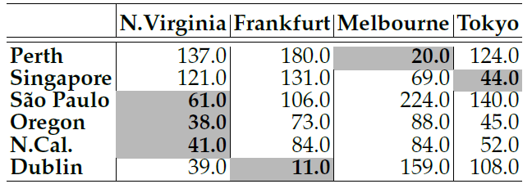
Results: dispatch times and destinations

Slide 39
Summary
Proposed a performance model and a simulator for 3-Tier apps in clouds;
Defined a generic architecture for such applications that honors the key functional and non-functional requirements;
Proposed a method for VM type selection during autoscaling;
Proposed and implemented a user redirection approach in Multi-Clouds.

Slide 40
Future Directions
Provisioning Techniques Using A Mixture of VM Pricing Models;
Dynamic Replacement of Application Server VMs;
VM Type Selection In Private Clouds;
Regulatory Requirements Specification Using Industry Standards;
Generalisation to Multi-Tier Applications.

Slide 41
List of publications
Nikolay Grozev and Rajkumar Buyya, “Inter-cloud Architectures and Application Brokering: Taxonomy and Survey”, Software: Practice and Experience, John Wiley & Sons, Ltd, vol. 44, no. 3, pp. 369–390, 2014;
Nikolay Grozev and Rajkumar Buyya, “Performance Modelling and Simulation of Three-Tier Applications in Cloud and Multi-Cloud Environments”, The Computer Journal, Oxford University Press, vol. 58, no. 1, pp. 1–22, 2015;
Nitisha Jain, Nikolay Grozev, J. Lakshmi, Rajkumar Buyya , “PriDynSim: A Simulator for Dynamic Priority Based I/O Scheduling for Cloud Applications”, Proceedings of the IEEE International Conference on Cloud Computing for Emerging Markets, 2015 (In Press);
Nikolay Grozev and Rajkumar Buyya, “Multi-Cloud Provisioning and Load Distribution for Three-tier Applications”, ACM Transactions on Autonomous and Adaptive Systems, vol. 9, no. 3, pp. 13:1–13:21, 2014;
Nikolay Grozev and Rajkumar Buyya, “Dynamic Selection of Virtual Machines for Application Servers in Cloud Environments”, Technical Report, CLOUDS Laboratory, The University of Melbourne, CLOUDS-TR-2016-1
Nikolay Grozev and Rajkumar Buyya, “Regulations and Latency Aware Load Distribution of Web Applications in Multi-Clouds”, Journal of Supercomputing (Under Review), 2015;

Slide 42
Acknowledgements
Supervisor: Professor Rajkumar Buyya;
Committee: Professor James Bailey, Dr. Rodrigo Calheiros;
Dr. Amir Vahid and Dr. Anton Beloglazov;
Past and Present CLOUDS Lab members and CIS Department;
Microsoft;
Amazon Inc;
Family and Friends.

Slide 43

Q&A
Thank you!

